Slide 1
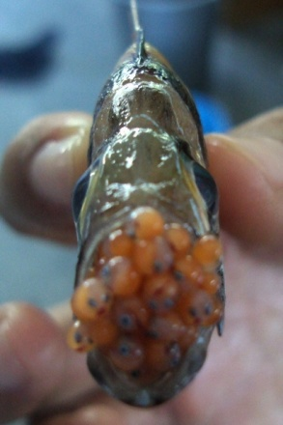
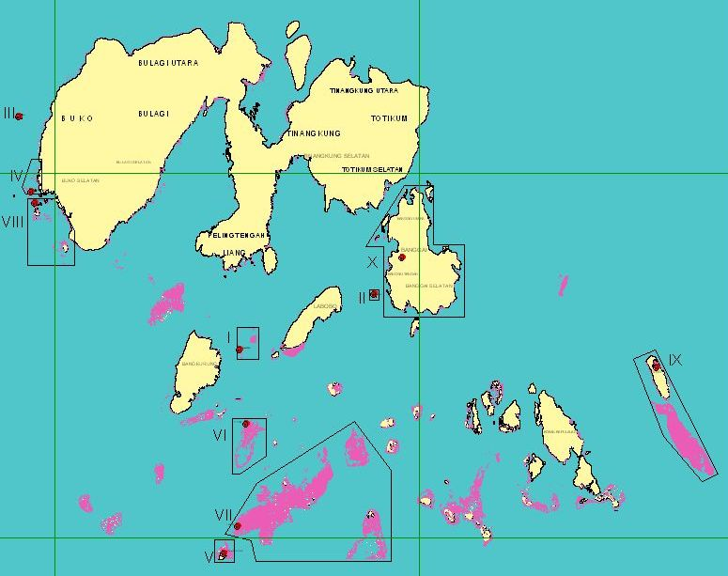
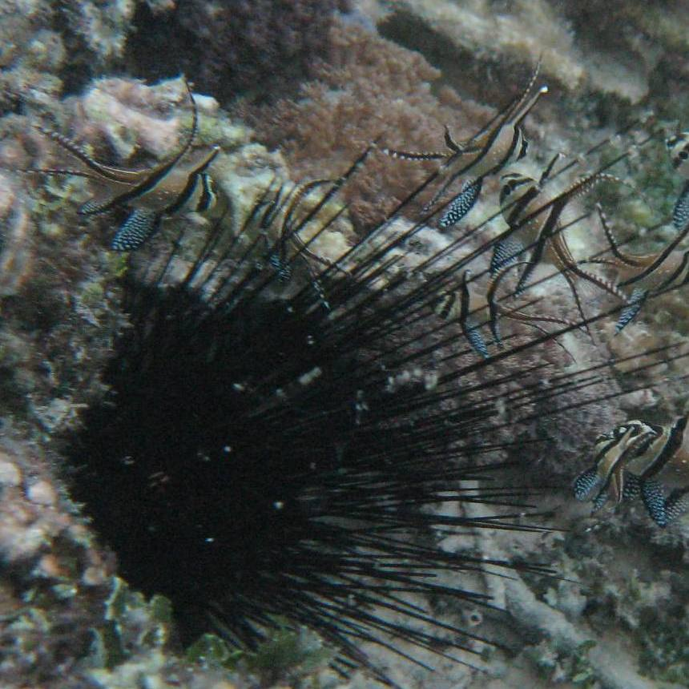
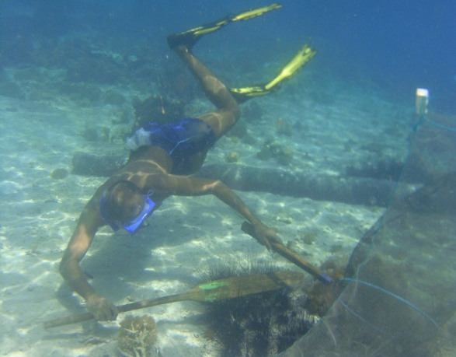
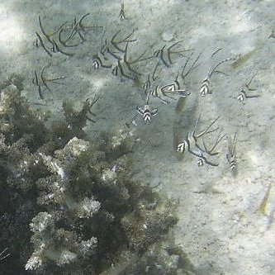




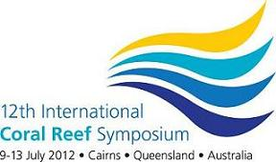
Banggai Cardinalfish Ornamental Fishery:
The Importance of Microhabitat
Abigail Moore
Samliok Ndobe
Al-Ismi Salanggon Ederyan
Abdul Rahman
abigail2105@yahoo.com
samndobe@yahoo.com

Slide 2
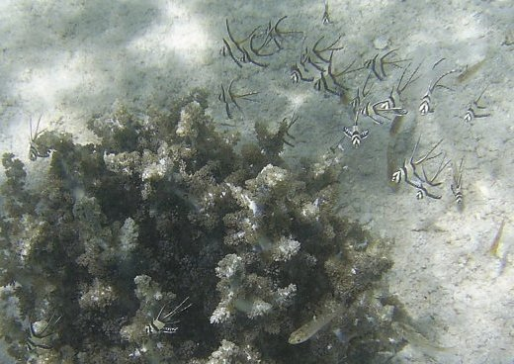
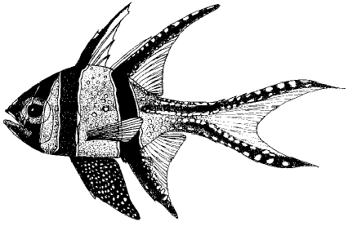
Outline
Background - BCF
Materials and Methods
The BCF Fishery
The BCF Trade
BCF Habitat & Population
Conclusion
Acknowledgement
Special thanks to the people and organisations who were directly involved in the survey and monitoring activities or provided data and information, financial, in-kind or moral support for the preparation and presentation of this paper. Conference attendance supported by the Conservation Leadership Programme (AM) and a 12th ICRS student grant (SN).
Notes:
2
2

Slide 3
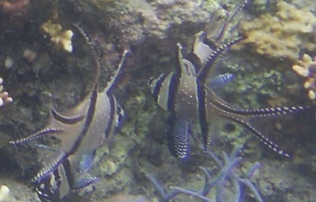
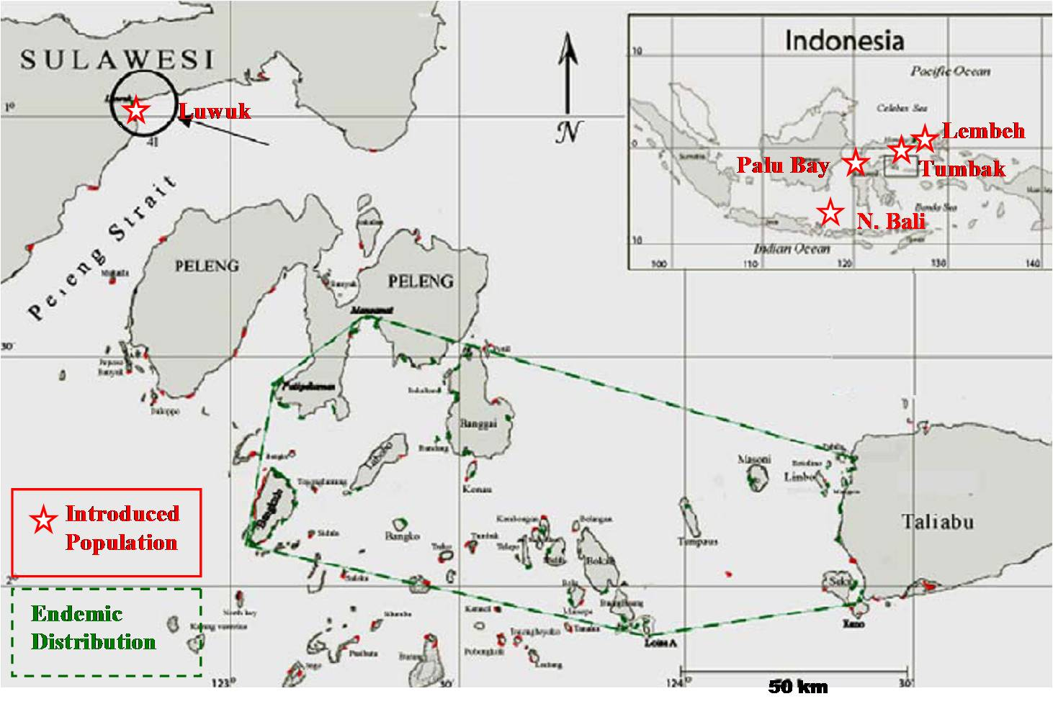
Background- BCF
Banggai cardinalfish (BCF) Pterapogon kauderni
Restricted range endemic species
IUCN Red List: Endangered
Kendari
Distribution: ± 5500km2
Habitat: 30-34 km2
Population: ± 2.4 million
(Vagelli, 2005)
Notes:
3
3

Slide 4
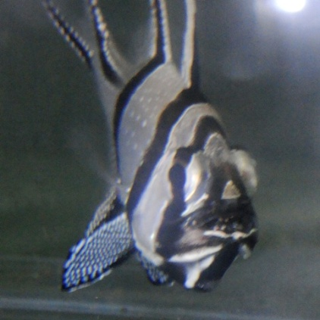
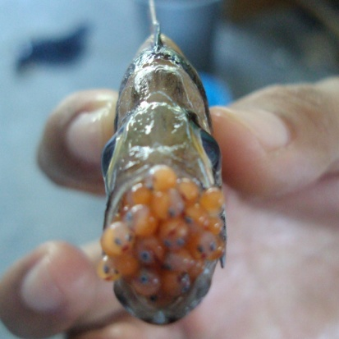
Background - BCF
6
1
Need for Monitoring and Evaluation
changes in the ornamental fishery
conservation outlook for P. kauderni,
the causes and impacts of habitat degradation.
Coral-reef associated:
Habitat (coastal waters < 5m depth) intensive use - threatened
Microhabitat threatened
Vulnerable to Extinction:
Paternal mouthbrooder with direct development
No pelagic phase
Sedentary & high site fidelity - extremely easy to catch
Relatively low fecundity
High risk of local extinction
IUCN Red List - Endangered
District MPA
10 Islands
2 islands designated for BCF conservation
Only 1 of these has a BCF population
2
5
4
3
National Initiatives:
National BCF Action Plan- multi-stakeholder, multi-year (2007-2012)
Indonesian NPOA CTI-CFF (National Plan of Actions - Coral Triangle Initiative on Coral Reef, Fisheries and Food Security): Target 4, Action 3
National legislation: in process
Ornamental Fish - International Concern:
Traded since late 1980's
High (600,000 to 1.4 million/year) volume relative to estimated total population (2.4 million)
Long & complex trade routes & high mortality
International concern (CITES proposal in 2007, articles, anti-wild-caught BCF campaigns)
Notes:
4
4

Slide 5
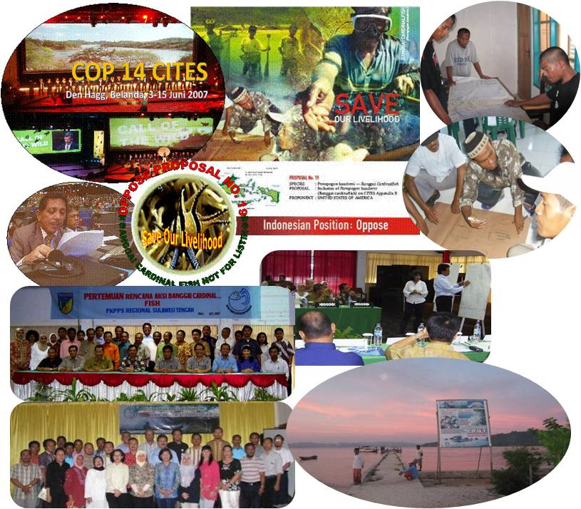
Background - BCF
National and International Issue
Considered endangered by overfishing for the marine aquarium trade
2007: Proposed for CITES Appendix II listing (by the USA) - withdrawn
2007: Listed as Endangered in the IUCN Red List
Indonesia - commitment to BCF conservation & sustainable use
BCF AP & BCF conservation in Indonesian Coral Triangle initiative Plan of Actions (NPOA)
Local Actions:
Community MPA (Bone Baru)
Ongoing research
Umbrella organisation: Banggai Cardinalfish centre (BCFC) established (2007)
Monitoring (Moore et al. in press)
Ongoing efforts to achieve a sustainable ornamental fishery
District MPA network (2007)
Notes:
5
5

Slide 6
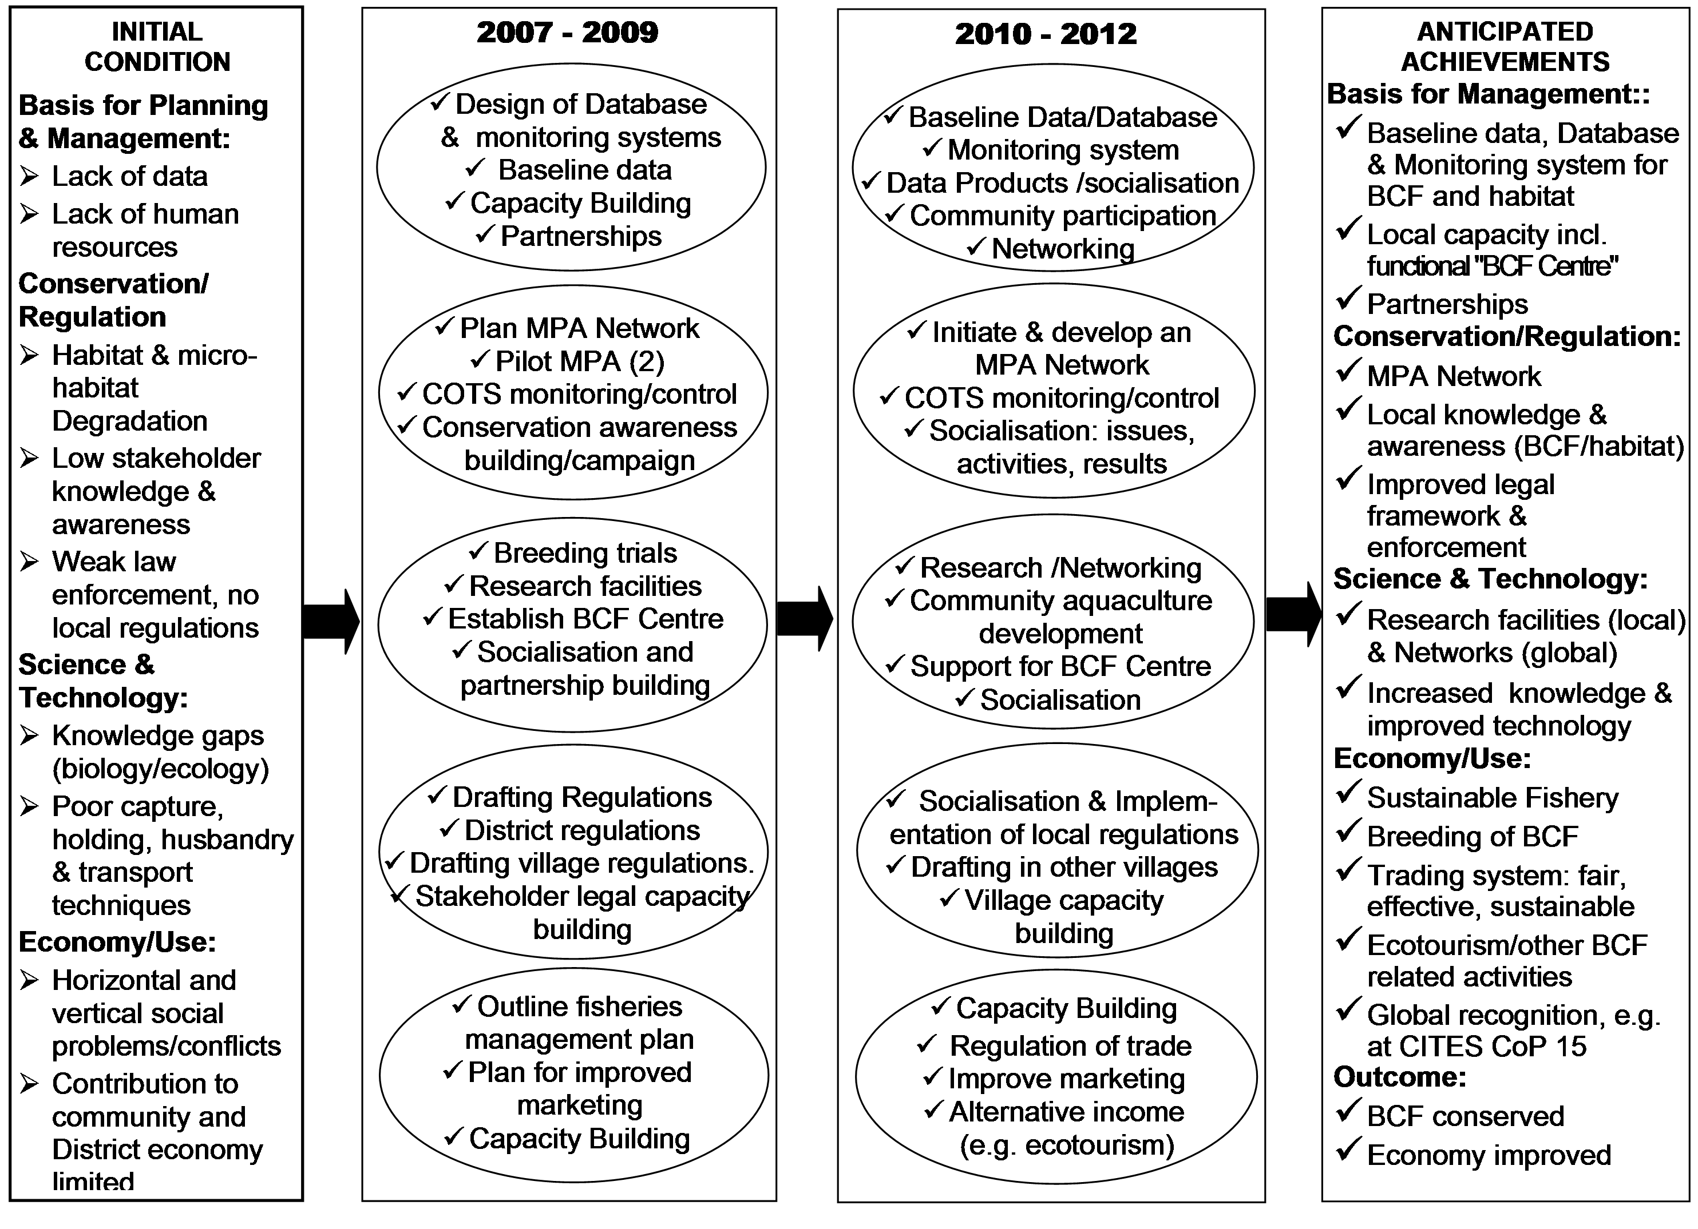
Background - BCF Action Plan
Notes:
6
6

Slide 7
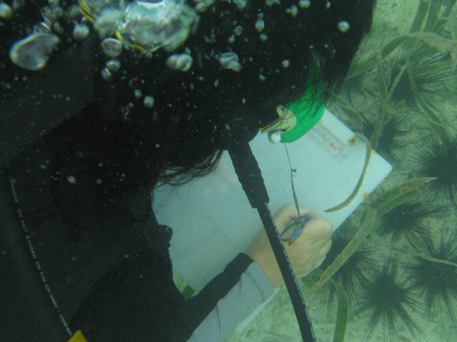
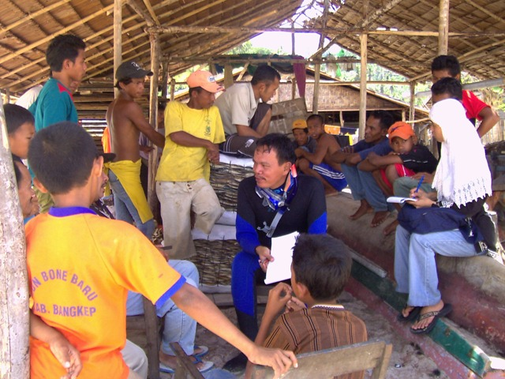
Materials & Methods
Primary data on BCF (P. kauderni) biology, ecology, fishery, and trade:
BCF-AP activities 2007-2011
Other field visits/research programs 2004 to 2012
Secondary data:
Fish Quarantine records
Banggai Cardinalfish Centre (BCFC): trade monitoring scheme (2008 & 2009) by the Marine and Fisheries Research Agency (BRKP), District Marine and Fisheries Service (MFS) & ornamental fishing community
Other BCF-AP government & non-government stakeholders (LINI etc)
Data analysed/reviewed to identify:
changes in the P. kauderni fishery and trade
conservation status/outlook for P. kauderni populations/habitat
Notes:
7
7

Slide 8
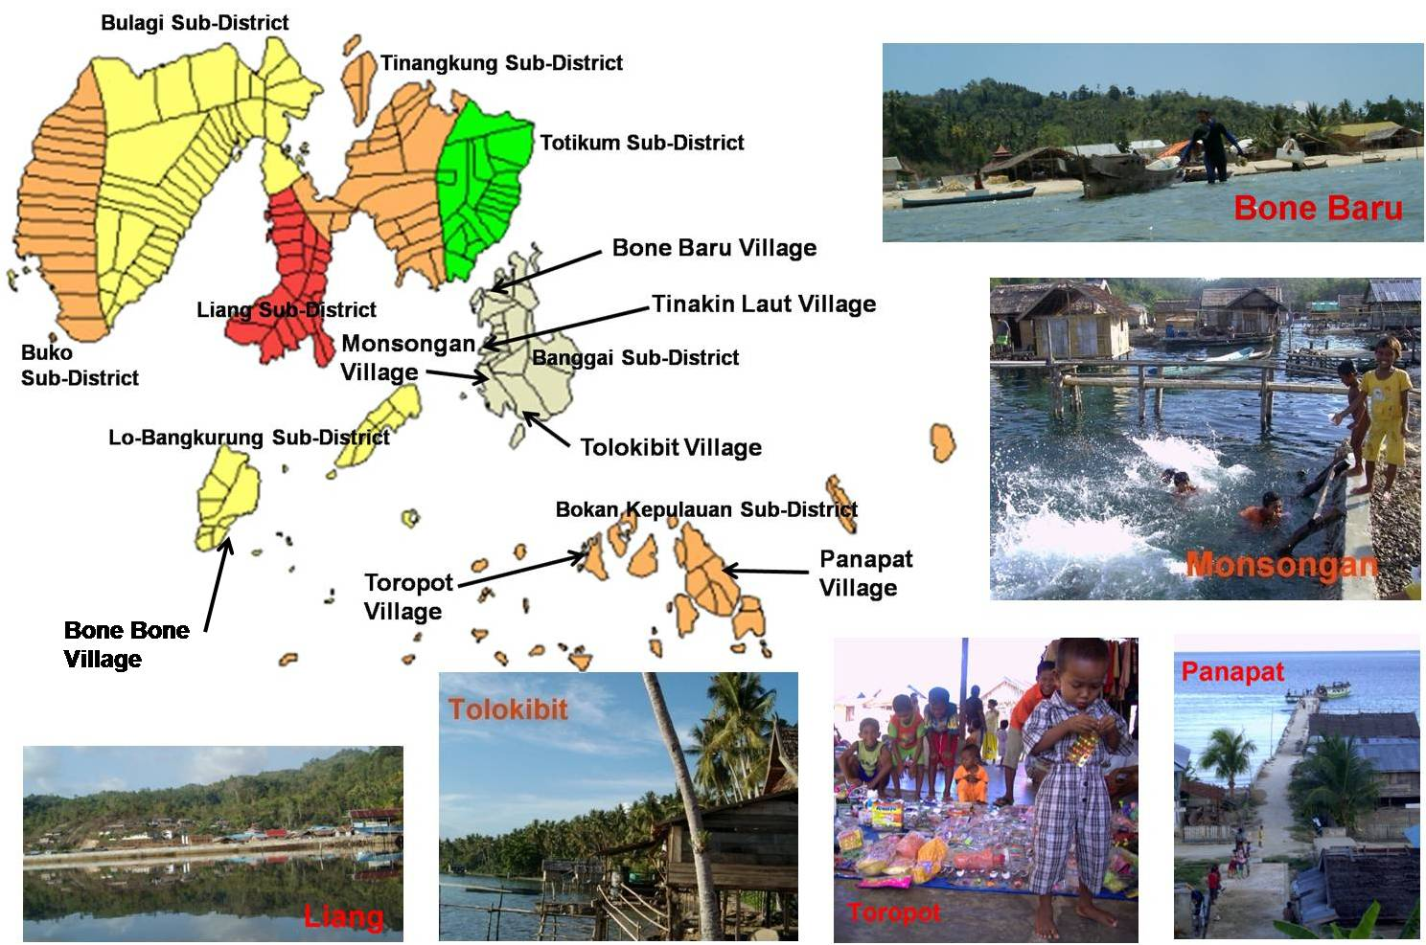
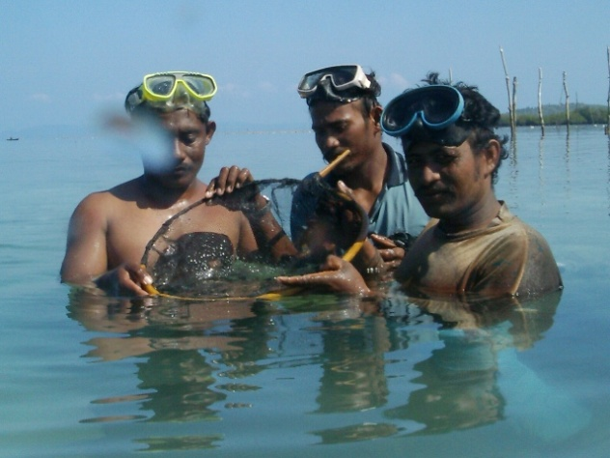
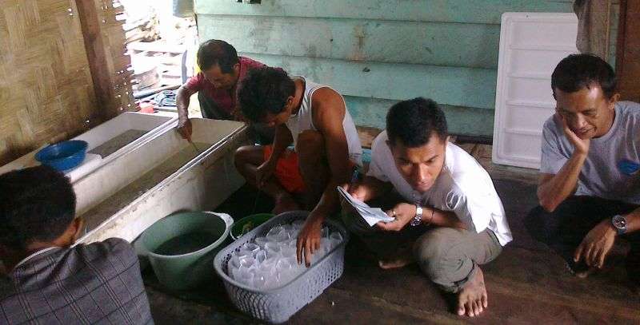
Multiple livelihood strategies
2001: around 12 BCF collecting villages Collecting BCF(Lunn & Moreau, 2004)
2011: 3 villages regularly collecting BCF
Two villages consistently collecting/trading BCF: Bone Baru & Bone Bone
Other villages: main reason for changes = buyers
Roving fishers (illegal) still a major problem
Collecting Villages & Fishers
The BCF Fishery
Island or Sub-District | Village | Status **
 |  | 2001* | 2004 | 2006- 2009 | 2011
Banggai | Bone Baru | A | A | A | A
 | Tinakin Laut | A | A | N | N
 | Monsongan | A | A | N | N
 | Tolokibit | A | A | N | A
 | Matanga | A | no data | N | N
Bokan Kepulauan | Toropot | A | A | A | N
 | Panapat | A | A | P | N
 | Kokudang | A | N | N | N
 | Mbuang-Mbuang | A | N | N | N
Bangkurung | Bone Bone | A | A | A | A
 | Dunkean | A | N | N | N
Other | 4 villages with very low volume | A | N | N | N

Slide 9
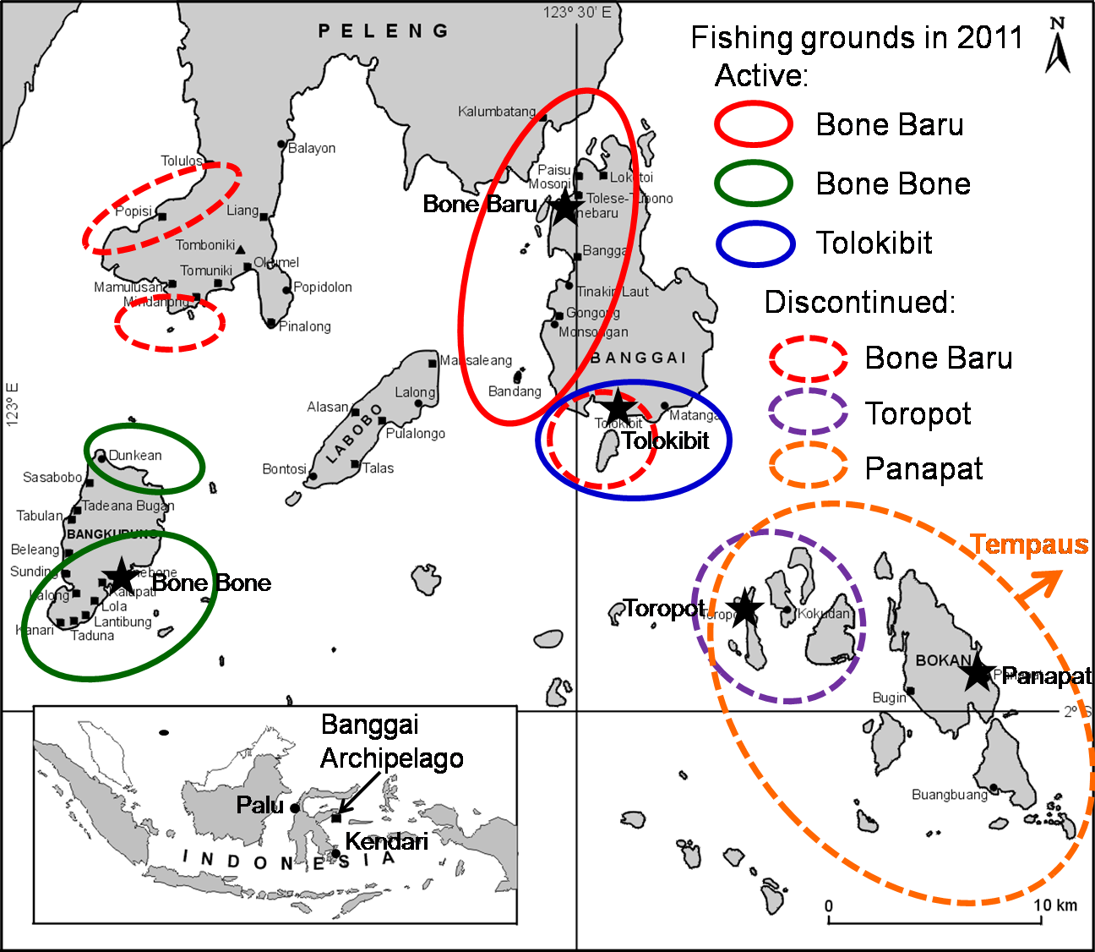
???
The BCF Fishery
Fishing Grounds 2004-2011
Reduction?June 2012...

Slide 10
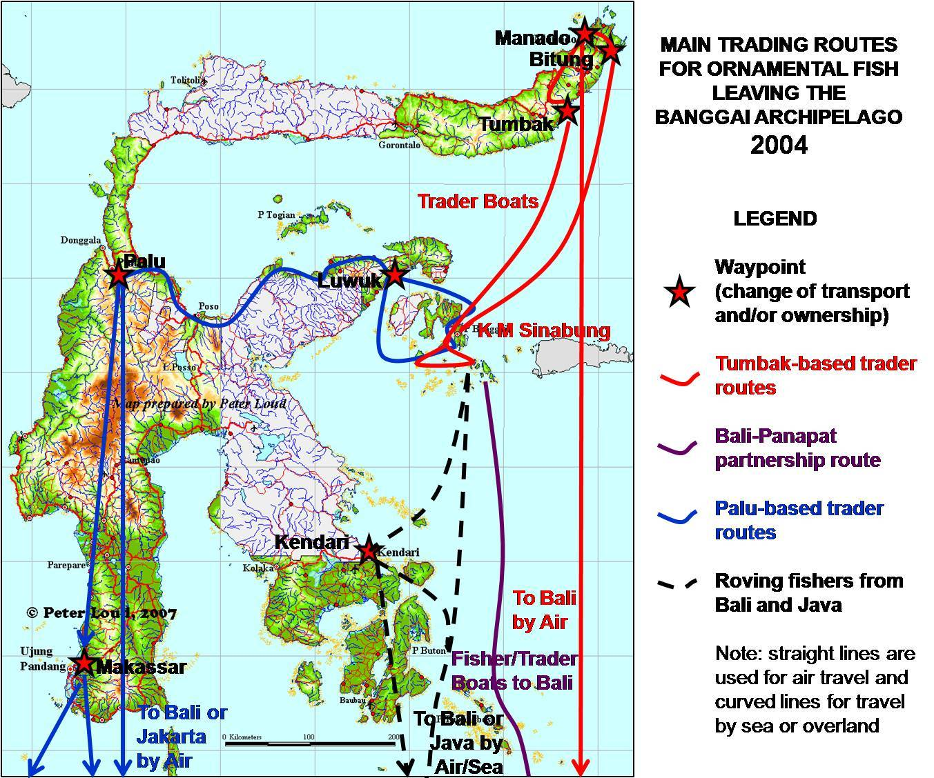
The BCF Trade
2001: Lunn & Moreau
2004: EC-PREP
2006: Sea Partnership (PMB)
2008/2009: MMAF etc monitoring (3 villages)
2008-now: Fish Quarantine data
2010, 2011, 2012 surveys
Changes in routes
Trader bases
Infrastructure
e.g. Luwuk-Jakarta (&Denpasar)
Quota system (2010): 15,000/month (problems)
Roving fishers still a problem
Competition - captive-bred fish
To Jakarta or Bali by Air
Parameter | Year | Bone Baru | Toropot | Bone Bone | Total
No. BCF caught | 2008 | 162,940 | 73,433 | no data | 236,373
 | 2009 | 155,156 | 89,340 | 85,920 | 330,416
Mortality (%) | 2008 | 2.60% | 0.70% | no data | 2.00%
 | 2009 | 0.10% | 0.30% | 0.80% | 0.30%
Parameter | 2008 (Feb-Dec) | 2009 | 2010 | 2011 (to June)
Number of fish traded legally | 83,200 | 215,950 | 148,800 | 56,900
Average monthly volume* | 7,564 | 17,996 | 12,400 | 9,483
% enumerator trade data | 36% | 66% | n/a | n/a

Slide 11
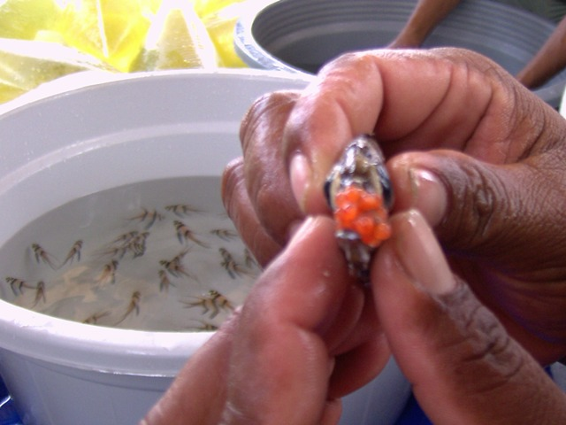
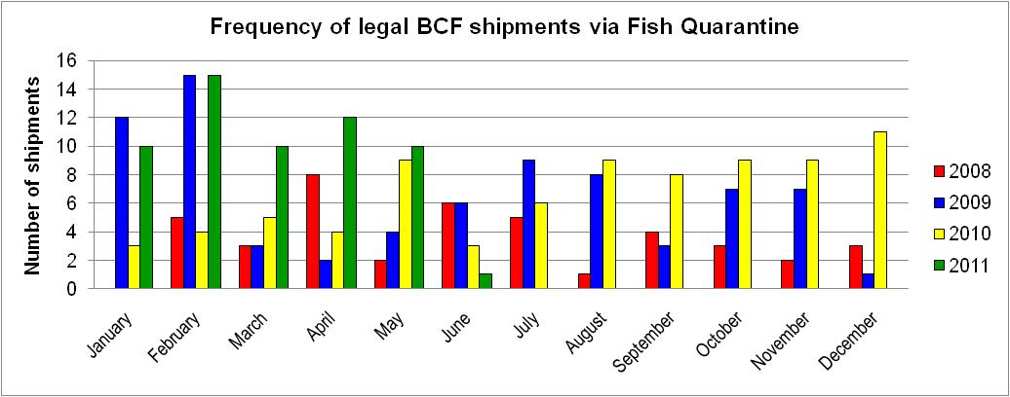
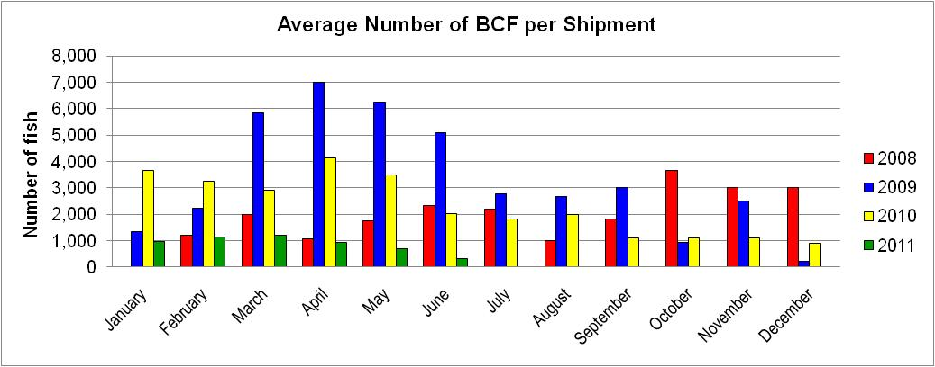
Monitoring the BCF Trade
Trade - Trends
Increase in legal trade
Decrease in illegal trade
Decrease in destructive practices (especially take of brooding males)
Decrease in size range and maximum/minimum sizes (target size now 2.5-3.5cm SL)
Decrease in mortality (improved handling)
Increase in price to fishers
Improved organisational structure (fisher group)
MORE SUSTAINABLE

Slide 12
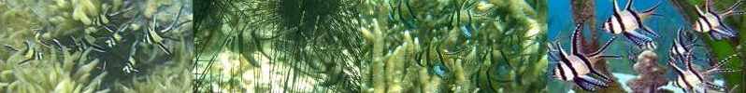
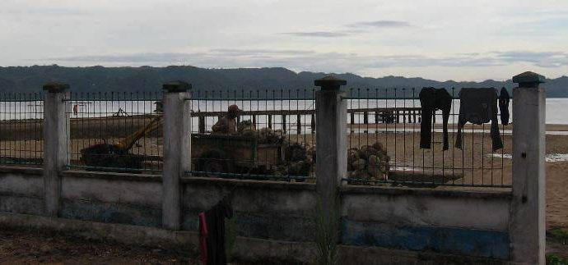
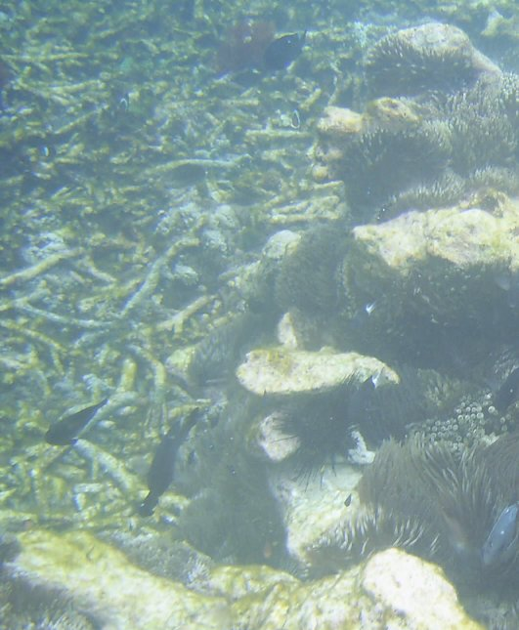
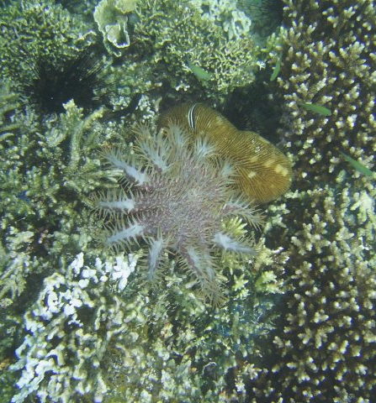
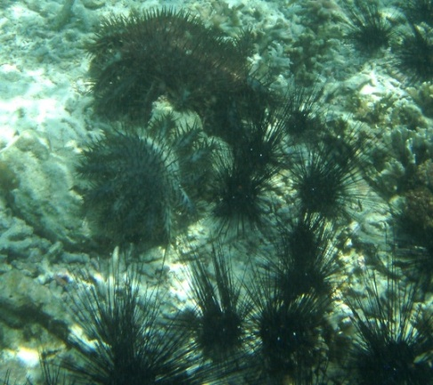
BCF Habitat &Population
Coral reef degradation widespread, many causes (Moore & Ndobe, 2009: data 2004, 2006, 2007)
2011: coral cover decline 2004-2011 at 5 sites around Banggai Island (e.g. 25% to 11%, Bone Baru transect)
Threats mostly at similar levels or increasing:
gleaning of invertebrates for consumption (intensive, but often not perceived as fishing) and sale (abalone)
general fishing pressure, including destructive methods (illegal & legal or unregulated)
coastal development (sea walls, public infrastructure, replacement of traditional homes)
illegally mined coral and sand by public works and local communities
Pressure on the land-based resources:
sedimentation, deleterious changes in hydrology, and water quality issues.
Acanthaster plancii outbreaks
Temperature-related coral bleaching not observed or reported up to December 2011, despite extensive bleaching in nearby Tomini Bay in 2010
Notes:
12
12

Slide 13
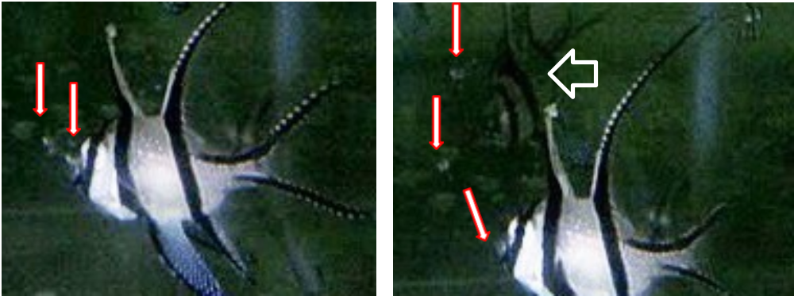
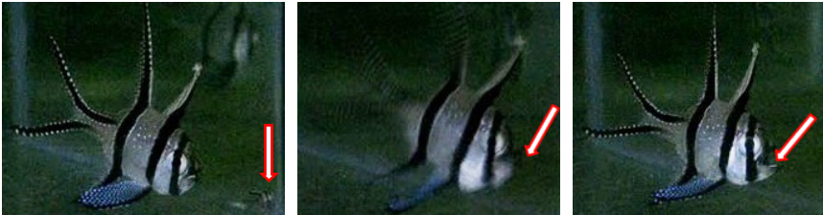
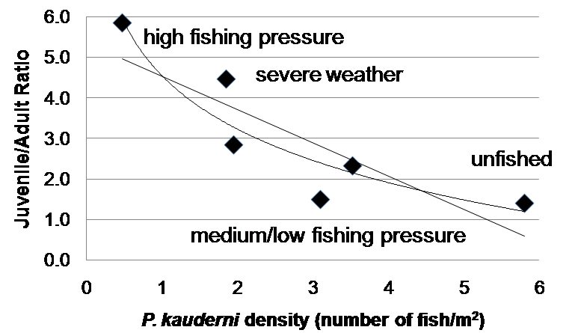
BCF Habitat &Population
Kolm and Berglund (2003): heavy fishing pressure correlated with lower P. kauderni population density
no significant difference between lightly/ moderately fished sites and un-fished sites
Confirmed by more recent survey/monitoring of endemic and Palu Bay introduced populations
All levels of fishing alter population structure:
higher percentages of recruits and smaller juveniles consistently observed at sites recently or regularly fished.
negative relationship between BCF density and juvenile:adult ratio - 6 sites around Banggai Island with various levels of fishing pressure
predation of newly released recruits by adult BCF (cannibalism) recorded in captivity (2010) and witnessed in the wild (2011&2012)
many indications that the survival rate of new recruits increases when the density of adult and sub-adult fish is reduced whether by fishing or other causes such as severe weather
Notes:
13
13

Slide 14
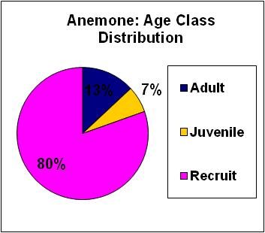
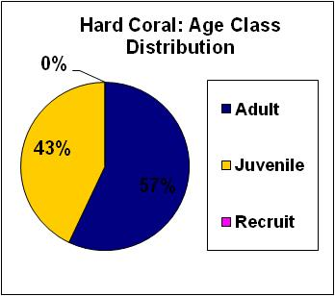
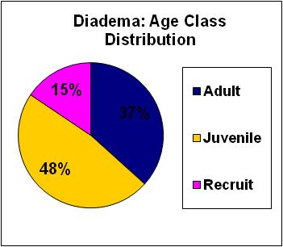
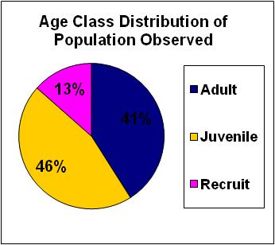
BCF Habitat &Population - Microhabitat
Study of microhabitat use by P. kauderni of 3 age/size classes (recruits: SL 6-15mm; juveniles SL 16-35mm; adults SL >35mm)
All size classes found in Diadema microhabitat, age structure close to overall population sampled.
Recruits comprised 80% of all P. kauderni associated with sea anemones
All recruit groups of more than 3 individuals, were associated with sea anemones, often also inhabited by clownfish (Amphiprion sp.)
Adults/large juveniles in hard coral microhabitat
Isolated recruits have been seen in branching or foliose corals as well as mushroom corals of the Genus Heliofungia
Notes:
14
14

Slide 15
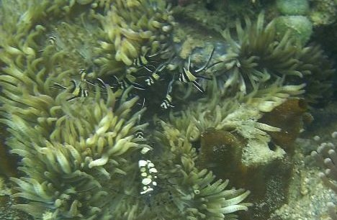
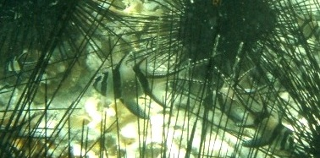
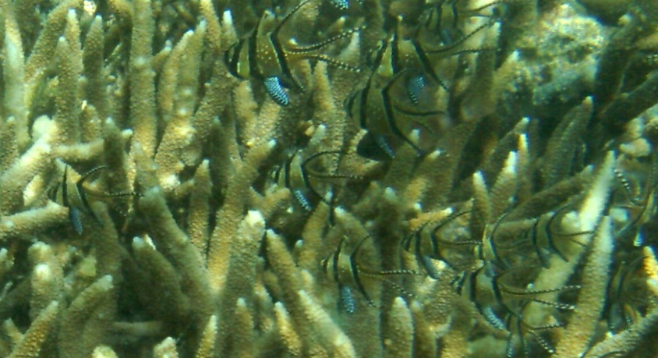
BCF Habitat &Population - Microhabitat
Predation of exposed P. kauderni recruits by fish of the Families Scorpaenidae, Labridae, Cirrhitidae and Gobiidae immediately or shortly after release from the male parents buccal pouch
small stonefish (Scorpaenidae) in unusually high numbers around male P. kauderni brooding well-developed larvae, subsequently predating recruits
Microhabitat: refuge from predation
Anemones: particularly important for new recruits
nearly all predators, including adult and sub-adult P. kauderni, seem to avoid the tentacles among which the smaller P. kauderni often hide, also benefitting from protection of the anemone by resident clown fish when present.
brooding males close to releasing their larvae have been observed near anemones, later found to be occupied by P. kauderni recruits.
often groups of 20 or more P. kauderni recruits in one sea anemone (sea urchins: groups of 1-3)
link with recruit release patterns?
Notes:
15
15

Slide 16
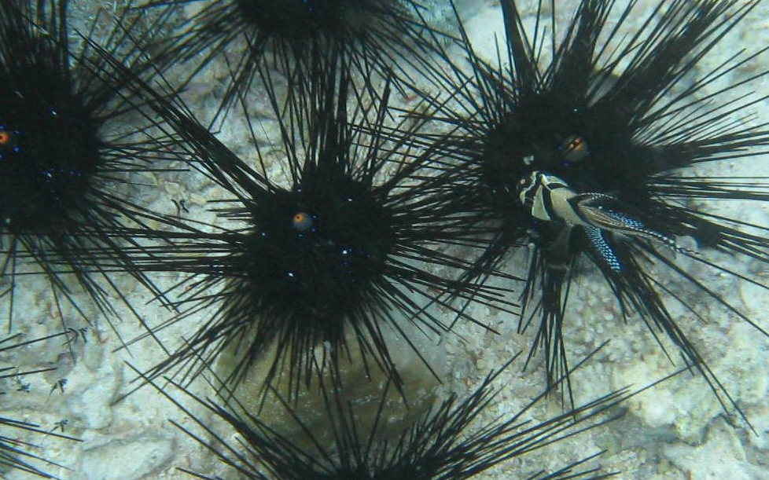
BCF Habitat &Population - Microhabitat
Notes:
16
16

Slide 17
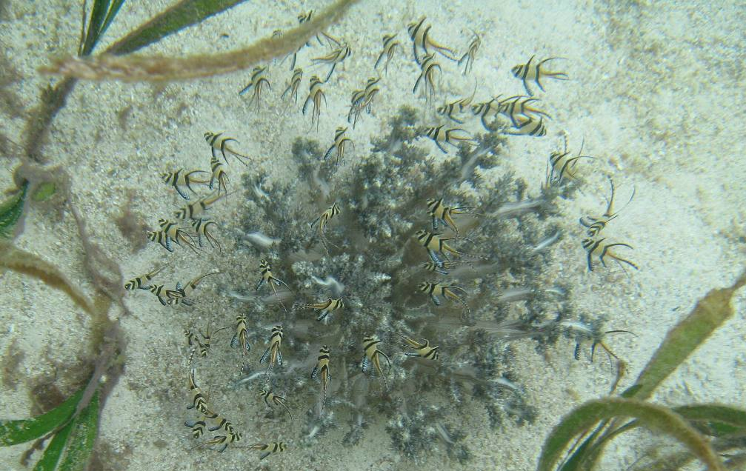
BCF Habitat &Population - Microhabitat
Notes:
17
17

Slide 18
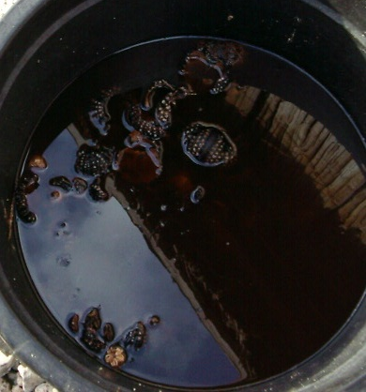
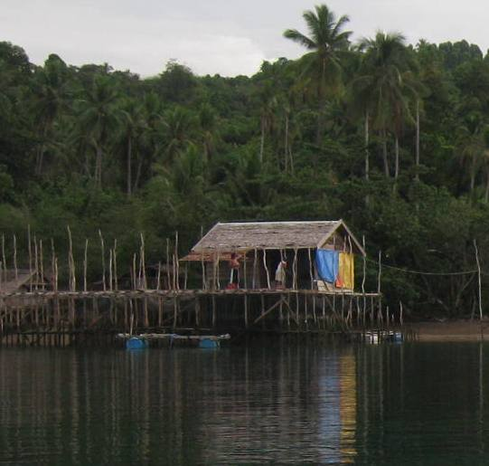
BCF Habitat &Population - Microhabitat
2007: first observed massive extraction (increase in long-standing practices) of key recruit microhabitat - drastic decline in P. kauderni population - sea anemones at Tinakin Laut; sea urchins in Tolokibit
P. kauderni recruits and small juveniles fell by an order of magnitude at Mamboro in Palu Bay after sea anemones were collected by local children
Reduction in sea urchin & sea anemone populations at another site in Palu Bay (cause unknown): almost all BCF crowded into the remaining urchins were adults. No recruits or small juveniles, despite large numbers of brooding males, indicating a sharp drop in recruit/juvenile survival
2009: seaweed farming related to shifts in fishing and consumption patterns: intensive harvesting of all edible benthic invertebrates including urchins/anemones
2011: sea urchins also harvested as feed for carnivorous fish (LRFT) especially Napoleon wrasse
Urchin & anemone decline: BCF decline, fished AND non-fished sites - 2012...
Notes:
18
18

Slide 19
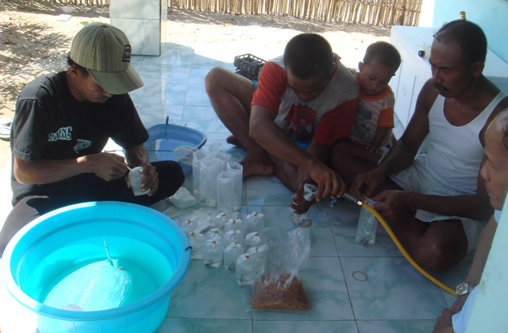
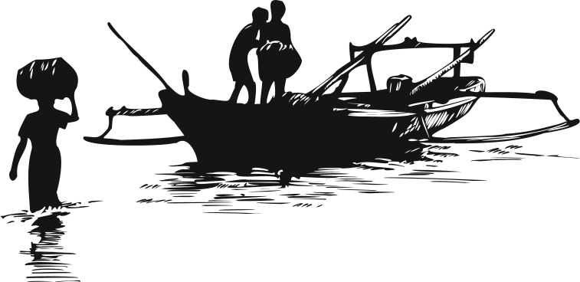
Conclusion
Many improvements in the BCF fishery and trade
Technical
Organisational
Economic
Should be approaching a SUSTAINABLE ORNAMENTAL FISHERY
BUT...

Slide 20
Conclusion
In a review of marine biodiversity patterns, threats and conservation needs, Gray (1997) stated that "loss of habitat is the most serious threat to marine biodiversity"
MICROHABITAT LOSS is now the major threat to BCF Conservation
Recent threat, caused by socio-economic changes
Involves many stakeholders who are unaware of the BCF - the species, the fishery, the conservation issues
Need for innovative solutions - including socialisation
Need for research & monitoring
Potential role of the BCFC - empower to co-ordinate (government, communities, scientists, etc)

Slide 21
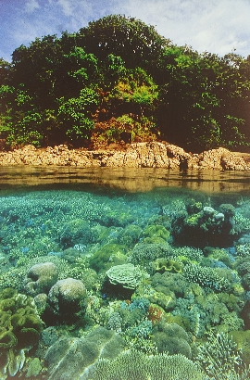
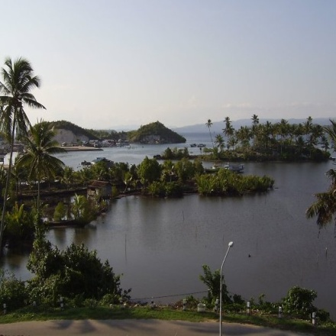


Let's Save the BCF
Together!
TERIMA KASIH
Thank You
Abigail Moore
Samliok Ndobe
Al-Ismi Salanggon Ederyan
Abdul Rahman
abigail2105@yahoo.com
samndobe@yahoo.com

